Slide 1

Psychopharmacology: Drugs, the Brain, and Behavior
by Meyer, Farrar, Biezonski, Yates

Slide 2
Chapter 1
Principles of Pharmacology
1.1 Pharmacology: The Science of Drug Action
1.2 Pharmacodynamics: Drug–Receptor Interactions

Slide 3
Chapter 1
Learning Objectives (1 of 4)
1.1.1 Identify the differences between drug action and drug effects; therapeutic effects and side effects; specific and nonspecific drug effects.
1.1.2 Describe placebo and nocebo effects and explain the psychological mechanisms that likely account for them. Explain the importance of the placebo control in a double-blind experimental design.

Slide 4
Chapter 1
Learning Objectives (2 of 4)
1.1.3 Explain how the following pharmacokinetic factors interact to determine drug bioavailability: absorption, distribution, biotransformation, and excretion.
1.1.4 List the major routes of administration and explain their advantages and disadvantages in terms of rate of onset, duration of action, convenience, and safety.
1.1.5 Describe how absorption, distribution, biotransformation, and excretion are influenced by the interaction between the chemical properties of the drug and biological properties of the body, including gastrointestinal tract pH, blood–brain and placental barriers, depot binding sites, enzymatic metabolism, and excretory processes.

Slide 5
Chapter 1
Learning Objectives (3 of 4)
1.2.1 Describe how drugs interact with the target tissue in terms of receptor-ligand binding.
1.2.2 Explain how receptor-ligand binding can be described in terms of affinity and efficacy; use these terms to describe how a drug is defined as an agonist, partial agonist, or antagonist.
1.2.3 Describe how dose-response relationships reflect receptor occupancy and activation, and can be used to describe the relative potency of a drug.

Slide 6
Chapter 1
Learning Objectives (4 of 4)
1.2.4 Explain the difference between competitive and non-competitive antagonists, and how co-administration of either of these would alter the dose-response curve of a receptor agonist.
1.2.5 Explain how the concept of therapeutic index is used to determine the relative safety of a drug.
1.2.6 Define tolerance and sensitization. Describe the mechanistic differences between pharmacodynamic, metabolic and behavioral tolerance.
1.2.7 Describe how pharmacogenetics can be used to optimize drug selection and dose based on genetic variability across individuals.

Slide 7
Pharmacology: The Science of Drug Action (1 of 24)
Pharmacology: the scientific study of the actions of drugs and their effects on a living organism
Specialized areas:
  Neuropharmacology: concerned with drug-induced changes to nervous system
  Psychopharmacology: concerned with drug-induced changes in mood, thinking, and behavior
  Neuropsychopharmacology: identify chemicals that can alter disturbed behavior; using chemicals as probes to understand the neurobiology of behavior
Notes:
Instructor Notes:

Slide 8
Pharmacology: The Science of Drug Action (2 of 24)
Drug action: specific molecular changes produced when drug binds to a particular target site or receptor
Drug effects: alterations in physiological or psychological functions
  Therapeutic effect: drug produces desired physical or behavioral changes
  Side effects: non-therapeutic effects
  Specific drug effects: based on physical and biochemical interactions of a drug with a target site in living tissue
  Nonspecific drug effects: based on unique characteristics of the individual
Notes:
Instructor Notes:

Slide 9
Pharmacology: The Science of Drug Action (3 of 24)
Placebo Effect
Placebo: pharmacologically inert compound; may have therapeutic effects and side effects
Effects include measurable physiological changes
May be due to Pavlovian conditioning, verbal suggestion, positive expectations, social learning, or genetics
Nocebo effect: increased anxiety or pain due to negative expectations
Notes:
Instructor Notes:

Slide 10
Pharmacology: The Science of Drug Action (4 of 24)
Placebo Effect
Placebos are essential in experimental design
Control group is unaware of placebo; comparison with experimental group provides information on effectiveness of the drug beyond the expectations of the participants.
Double-blind experiment: neither patient nor observer knows what treatment the participant has received
Notes:
Instructor Notes:

Slide 11
Pharmacology: The Science of Drug Action (5 of 24)
Pharmacokinetic Factors Determining Drug Action
Bioavailability: amount of drug in the blood that is free to bind at specific target sites
Pharmacokinetic components of drug action contribute to bioavailability.
Notes:
Instructor Notes:

Slide 12
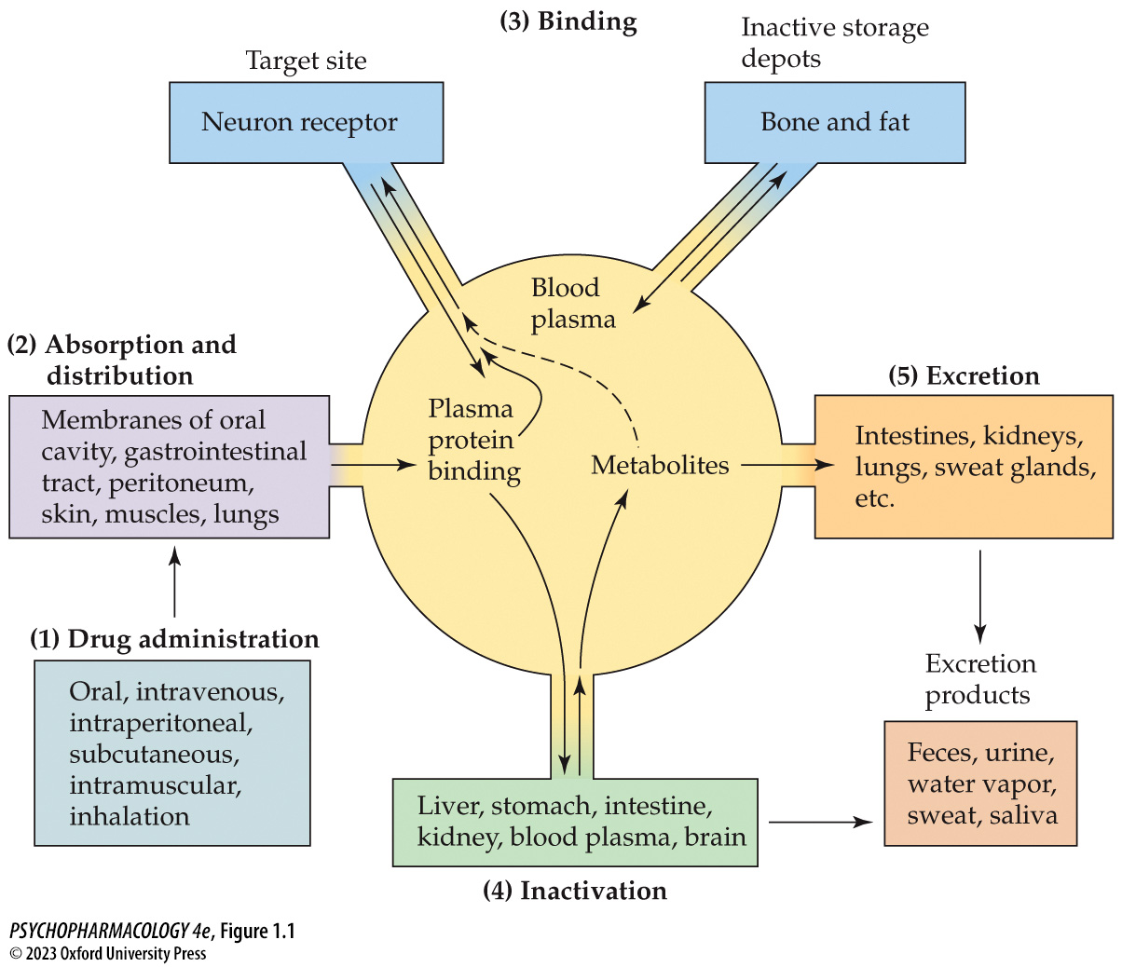
FIGURE 1.1 Pharmacokinetic factors that determine bioavailability of drugs
Notes:
FIGURE 1.1 Pharmacokinetic factors that determine bioavailability of drugs
From the site of administration (1), the drug moves through cell membranes to be absorbed into the blood (2), where it circulates to all cells in the body. Some of the drug molecules may bind to inactive sites such as plasma proteins or storage depots (3), and others may bind to receptors in target tissue. Bloodborne drug molecules also enter the liver (4), where they may be transformed into metabolites and travel to the kidneys and other discharge sites for ultimate excretion (5) from the body.

Slide 13
Pharmacology: The Science of Drug Action (6 of 24)
Methods of Drug Administration Influence the Onset of Drug Action
Systemic routes: drug moves throughout the body through general circulation
Oral administration (PO): drug must pass through stomach or intestine wall to reach blood capillaries; must be resistant to destruction by stomach acid and enzymes
Absorption: movement of drug from the site of administration to the blood circulation
Notes:
Instructor Notes:
Enteral methods use the GI tract (oral and rectal); parenteral methods include injection and pulmonary administration.

Slide 14
Pharmacology: The Science of Drug Action (7 of 24)
Methods of Drug Administration Influence the Onset of Drug Action
First-pass metabolism: ingested chemicals pass via the portal vein to the liver, where they are altered by enzymes before passing to the general circulation
Oral therapeutic drugs may undergo metabolism that reduces their bioavailability.
Notes:
Instructor Notes:

Slide 15
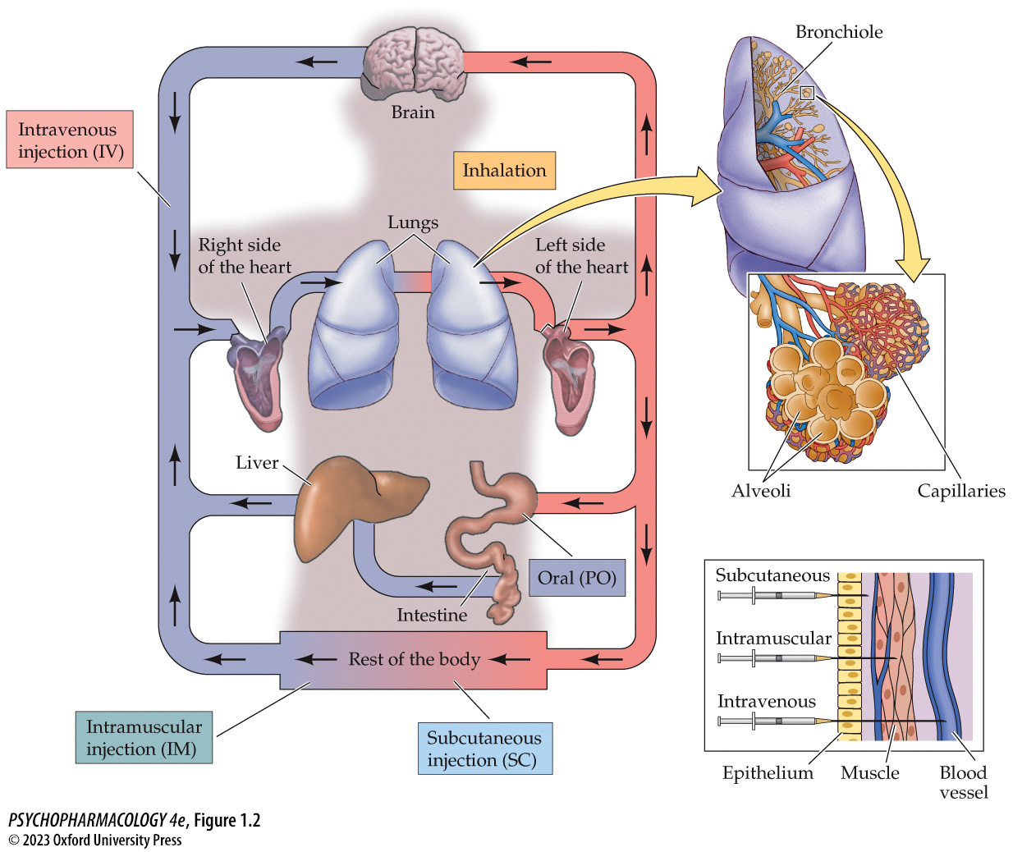
FIGURE 1.2 Routes of drug administration
Notes:
FIGURE 1.2 Routes of drug administration
First-pass effect. Drugs administered orally are absorbed into the blood and must pass through the liver before reaching the general circulation. Some drug molecules may be destroyed in the liver before they can reach target tissues. The arrows indicate the direction of blood flow in the arteries (red) and veins (blue). (Top inset) Pulmonary absorption through capillaries in the alveoli. Rapid absorption occurs after inhalation because the large surface area of the lungs and the rich capillary networks provide efficient exchange of gases to and from the blood. (Bottom inset) Methods of administration by injection. The speed of absorption of drug molecules from administration sites depends on the amount of blood circulating to that area.

Slide 16
Pharmacology: The Science of Drug Action (8 of 24)
Methods of Drug Administration Influence the Onset of Drug Action
Intravenous (IV): rapid and accurate; drug goes directly into bloodstream; danger of overdose
Intramuscular (IM) injection: slower, more even absorption over time
Subcutaneous (SC) injection: just below the skin; drug pellets can be used to deliver hormones such as contraceptives
Inhalation: drug is absorbed by passing through the lungs
Notes:
Instructor Notes:
Rectal administration: the drug may avoid some first-pass metabolism
Intraperitoneal (IP) injection: into peritoneal cavity – mostly used for laboratory animals.
Sublingual: under the tongue; rapid absorption into capillaries; avoids first-pass metabolism

Slide 17
Pharmacology: The Science of Drug Action (9 of 24)
Methods of Drug Administration Influence the Onset of Drug Action
Topical application to mucus membranes: local effects
Intranasal: local effects but moves rapidly into blood; avoids first-pass metabolism; bypasses blood-brain barrier
Transdermal: through the skin with skin patches; avoids first-pass metabolism
Epidural: injection into epidural space; bypasses blood-brain barrier
Notes:
Instructor Notes:
Intranasal administration bypasses the blood–brain barrier, perhaps by direct access to the cerebrospinal fluid [CSF] and moving from there to extracellular fluid found in the intercellular
spaces between neurons.
Central routes of administration for drugs that act on neurons:
Intrathecal injection into subarachnoid space
Intracranial injection into discrete areas of brain tissue
Intracerebroventricular injection into ventricles
Infusion pump delivers constant dose to ventricles
Infusion pump is used to administer antibiotics for cerebral meningitis; also used for systemic drugs, e.g., insulin.
Viral vectors are under research as a delivery mechanism for DNA in gene therapy.

Slide 18
Pharmacology: The Science of Drug Action (10 of 24)
Methods of Drug Administration Influence the Onset of Drug Action
Route of administration alters the rate of absorption and thus blood levels of the drug (bioavailability).
Peak levels reflect absorption rate and metabolism in the liver.
Notes:
Instructor Notes:

Slide 19
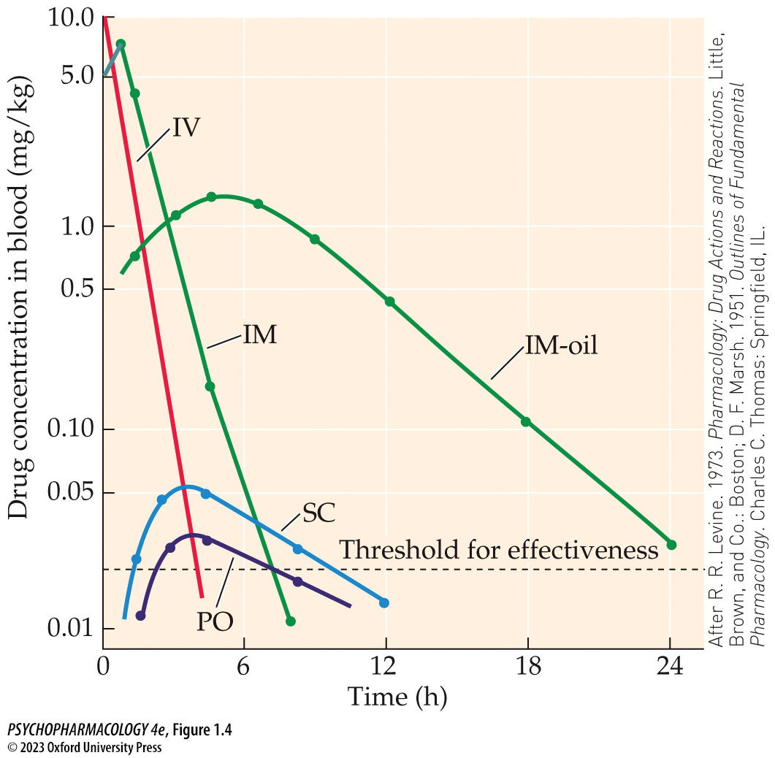
FIGURE 1.4 The time course of drug blood level depends on route of administration
Notes:
FIGURE 1.4 The time course of drug blood level depends on route of administration
The blood level of the same amount of drug administered by different procedures to the same indi­vidual varies significantly. Intravenous (IV) administration produces an instantaneous peak when the drug is placed in the blood, followed by a rapid decline. Intramuscular (IM) administration produces rapid absorption and rapid decline, although IM admin­istration in oil (IM-oil) shows slower absorption and gradual decline. Slow absorption after subcutaneous (SC) administration means that some of the drug is metabolized before absorption is complete. For this reason, no sharp peak occurs, and overall blood levels are lower. Oral (PO) administration produces the lowest blood levels and a relatively short time over threshold for effectiveness in this instance. (After R. R. Levine. 1973. Pharmacology: Drug Actions and Reactions. Little, Brown, and Co.: Boston; D. F. Marsh. 1951. Outlines of Fundamental Pharmacology. Charles C. Thomas: Springfield, IL.)

Slide 20
Pharmacology: The Science of Drug Action (11 of 24)
Multiple Factors Modify Drug Absorption
Route of administration
Drug concentration
Solubility and ionization of the drug
Rate of transport across cell membranes – bilayers of phospholipid molecules
Notes:
Instructor Notes:

Slide 21
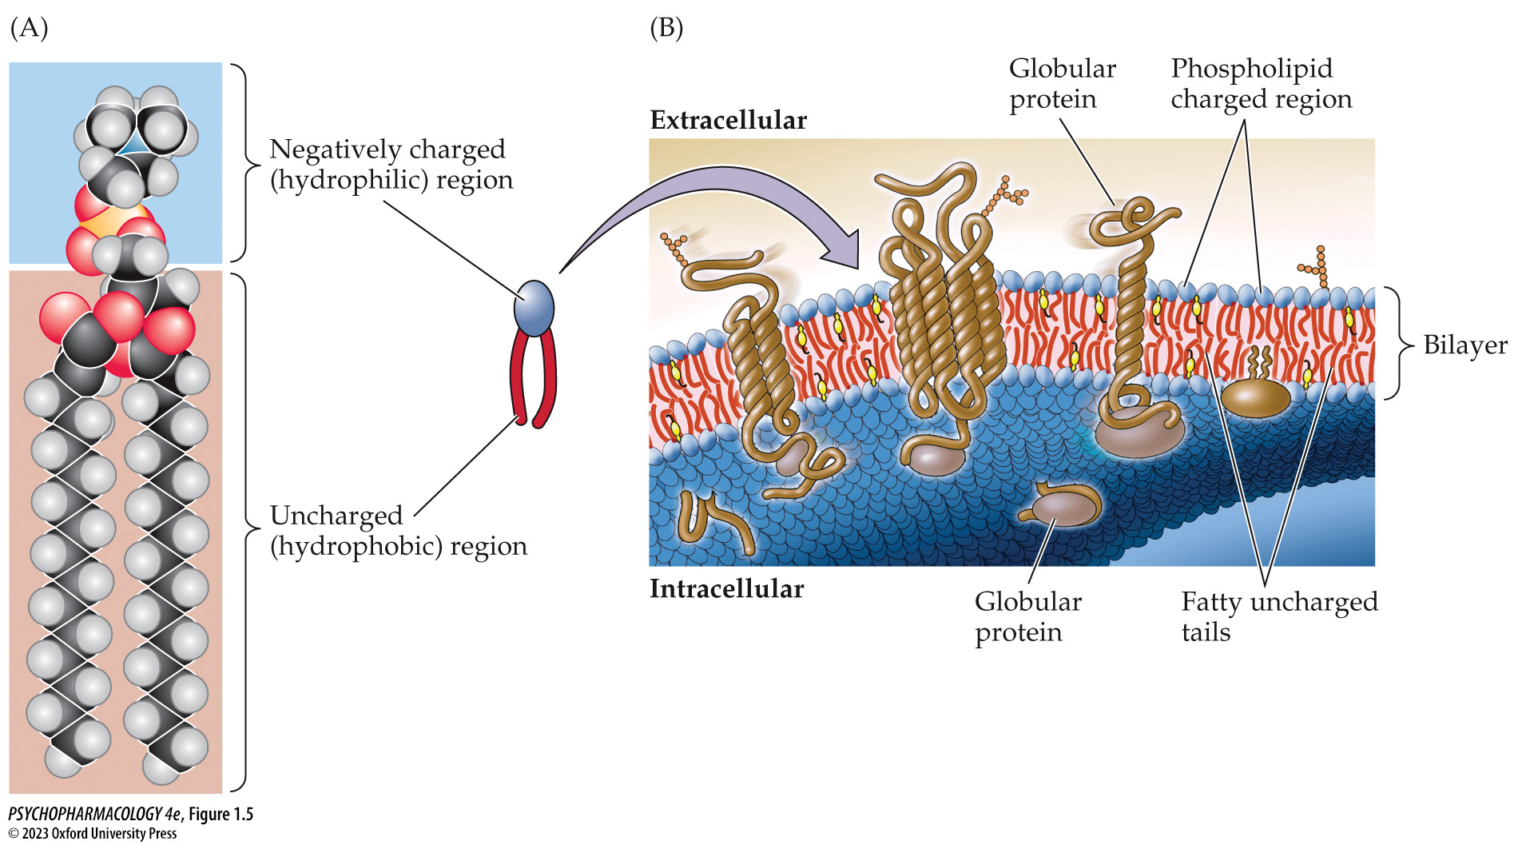
FIGURE 1.5 Cell membranes
Notes:
FIGURE 1.5 Cell membranes
(A) Example of a phospholipid molecule with a negatively charged group (PO₄⁻) at one end (hydrophilic) and two fatty uncharged tails (hydrophobic). (B) The arrangement of individual phospholipid molecules forms a bilayer, with negatively charged heads attracted to the water molecules of both intracellular and extracellular fluids. The fatty tails of the molecules are tucked within the two charged layers and have no contact with aqueous fluid. Embedded in the bilayer are protein molecules that serve as receptors or channels.

Slide 22
Pharmacology: The Science of Drug Action (12 of 24)
Multiple Factors Modify Drug Absorption
Lipid-soluble drugs move through cell membranes by passive diffusion.
  Diffusion is from higher to lower concentration (concentration gradient) .
  Lipid solubility increases absorption and entry into the brain.
Bioactivation: inactive drug is metabolized into an active form
Notes:
Instructor Notes:

Slide 23
Pharmacology: The Science of Drug Action (13 of 24)
Multiple Factors Modify Drug Absorption
Most drugs are weak acids or bases that partially ionize in water
Degree of ionization depends on pH and pK_{a}
pK_{a}: pH of the solution in which that drug would be 50% ionized and 50% non-ionized.
Non-ionized form is more lipid soluble; can pass cell membranes and enter the blood more easily.
Notes:
Instructor Notes:
Other factors include rate of passage through the stomach. Greater surface area and slower movement through small intestines = more opportunity for absorption.
Drug dosage depends on size and sex of an individual.

Slide 24
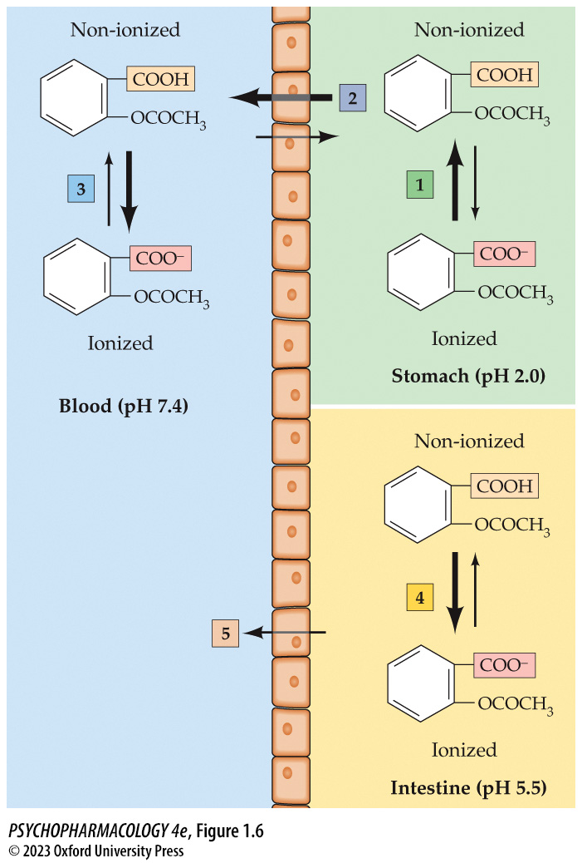
FIGURE 1.6 Effect of ionization on drug absorption
Notes:
FIGURE 1.6 Effect of ionization on drug absorption
On the right side of the cell barrier in stomach acid (pH 2.0), aspirin molecules tend to remain in the non-ionized form (1), which promotes the passage of the drug through the cell walls (2) to the blood. Once the intact aspirin molecules reach the blood (pH 7.4), they ionize (3) and are “trapped” in the blood to be circulated throughout the body. In the lower portion of the figure, when the aspirin has reached the intestine, it tends to dissociate to a greater extent (4) in the more basic pH. Its more ionized form reduces passage (5) through the cells to the blood, so absorption from the intestine is slower than from the stomach.

Slide 25
Pharmacology: The Science of Drug Action (14 of 24)
Drug Distribution Is Limited by Selective Barriers
Once a drug enters the blood it is quickly delivered to areas with high blood flow.
Those areas will initially have a high drug concentration; as plasma levels fall, the drug is redistributed until it reaches equilibrium in all tissues.
Drug redistribution can terminate drug action.
Notes:
Instructor Notes:

Slide 26
Pharmacology: The Science of Drug Action (15 of 24)
Drug Distribution Is Limited by Selective Barriers
Blood-brain barrier: separation between brain capillaries and cerebrospinal fluid (CSF); selectively permeable
Brain capillaries: endothelial cells are fused by tight junctions; most materials move by special transporters
Brain capillaries are surrounded by extensions of astroglia (astrocytes) – essential to maintaining the blood-brain barrier
Notes:
Instructor Notes:
Typical capillaries: endothelial cells with intercellular clefts and fenestrations that allow molecules to pass, plus pinocytotic vesicles to transport larger molecules.

Slide 27
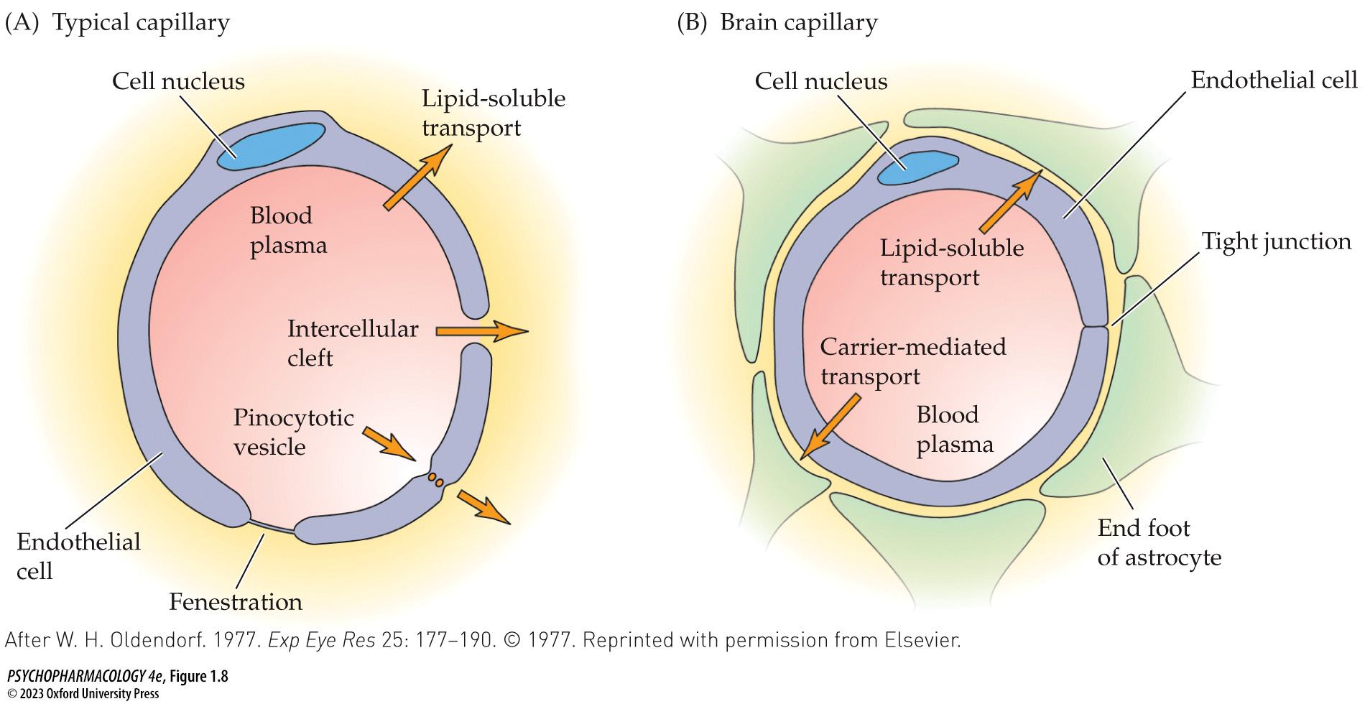
FIGURE 1.8 Cross-section of typical capillaries and brain capillaries
Notes:
FIGURE 1.8 Cross-section of typical capillaries and brain capillaries
(A) Capillaries found throughout the body have characteristics that encourage movement of materials between the blood and surrounding cells. (B) Brain capillaries minimize movement of water-soluble molecules through the blood vessel wall because there are essentially no large or small clefts or pinocytotic sites. (After W. H. Oldendorf. 1977. Exp Eye Res 25: 177–190. © 1977. Reprinted with permission from Elsevier.)

Slide 28
Pharmacology: The Science of Drug Action (16 of 24)
Drug Distribution Is Limited by Selective Barriers
Placental barrier: separation of blood circulation between mother and fetus at the placenta
Transfer of drugs from mother to fetus can cause:
  Acute toxicity – opiates, alcohol, and other drugs; action can be prolonged after birth due to slow metabolism
  Teratogenic effects – causing developmental abnormalities; depends on time of exposure – most severe in early pregnancy
Notes:
Instructor Notes:

Slide 29
Pharmacology: The Science of Drug Action (17 of 24)
Depot Binding Alters the Magnitude and Duration of Drug Action
Binding of drugs to inactive sites (drug depots or silent receptors) – affects magnitude and duration of drug action
  Reduces concentration of drug at action sites
  Nonselective binding can cause competition between drugs and possible overdose
  Bound drug molecules can be altered by liver enzymes – prolongs time drug is in the body
  Redistribution to inactive sites
Notes:
Instructor Notes:
See Table 1.4

Slide 30
Pharmacology: The Science of Drug Action (18 of 24)
Biotransformation and Elimination of Drugs Contribute to Bioavailability
Biotransformation (metabolism) and excretion eliminate drugs from the body.
Drug clearance from the blood is exponential (first-order kinetics).
Half-life: amount of time required for removal of 50% of the drug (t_{½}); determines time needed to reach the steady state plasma level (the desired blood concentration).
Notes:
Instructor Notes:
When blood levels are high, clearance is faster, as blood levels drop, rate of clearance is reduced.
Clearance is also dependent on biotransformation rate, depot binding, and storage in reservoirs such as fat.
Steady state plasma level is the desired blood concentration of drug achieved when the absorption/distribution phase is equal to the metabolism/excretion phase. It is approached after a period of time equal to five half-lives.
Some drugs are cleared according to zero-order kinetics.

Slide 31
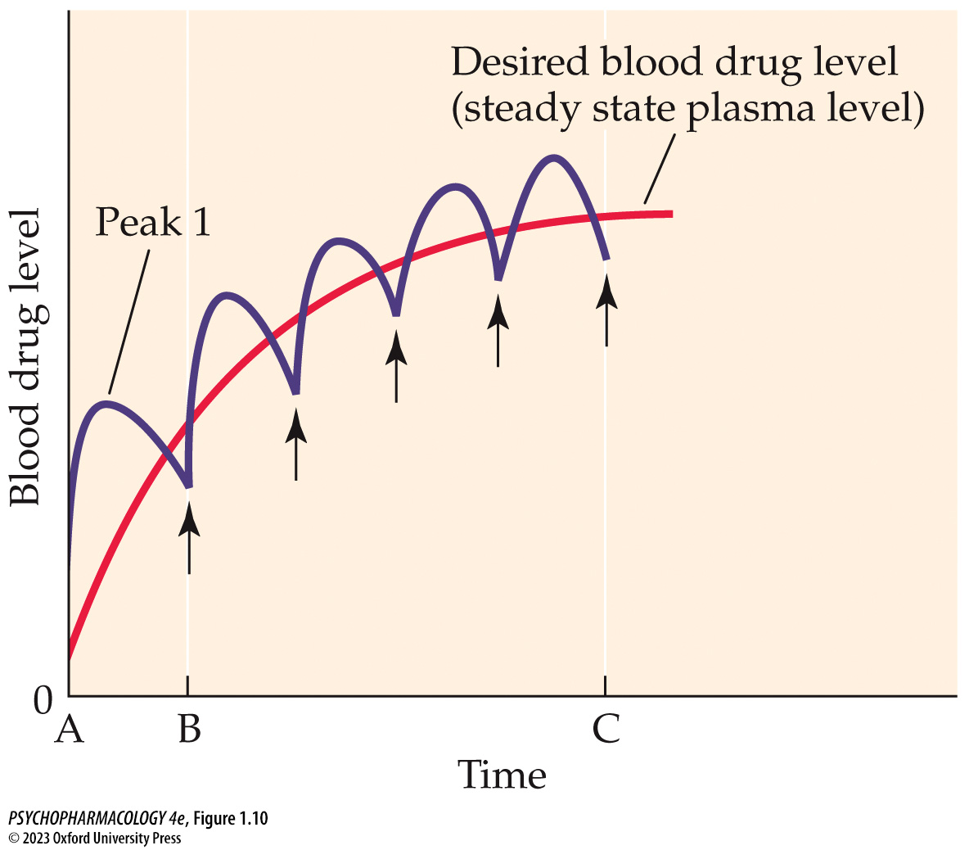
FIGURE 1.10 Achieving steady state plasma levels of drug
Notes:
FIGURE 1.10 Achieving steady state plasma levels of drug
The scalloped line shows the pattern of accumulation during repeated administration of a drug. The arrows represent the times of administration. The shape of the scallop is dependent on both the rate of absorption and the rate of elimination. The smooth line represents drug accumulation in the blood during continuous intravenous infusion of the same drug.

Slide 32
Pharmacology: The Science of Drug Action (19 of 24)
Biotransformation and Elimination of Drugs Contribute to Bioavailability
Most biotransformation occurs in the liver:
  Phase I – oxidation, reduction, or hydrolysis
  Phase II – synthetic reactions – products are ionized, water soluble, and biologically inactive
Drugs that are converted to active metabolites have a prolonged duration of action.
Notes:
Instructor Notes:
See Table 1.6
Liver enzymes (microsomal enzymes) that metabolize psychoactive drugs are located on the smooth ER; lack specificity and can metabolize a wide variety of foreign chemicals. The cytochrome P450 (CYP450) enzyme family is responsible for oxidizing most psychoactive drugs.

Slide 33
Pharmacology: The Science of Drug Action (20 of 24)
Biotransformation and Elimination of Drugs Contribute to Bioavailability
Factors that influence rate of biotransformation:
  Enzyme induction: repeated use of drug increases number of enzymes; increases rate
  Enzyme inhibition: reduces metabolism of other drugs that use the same enzyme
  Drug competition: elevated levels of one drug reduces metabolism of the second
  Individual differences in age, gender, and genetics.
Notes:
Instructor Notes:
Genetic polymorphisms for drug-metabolizing enzymes contribute to variability in metabolism.
The enzymes that have been studied most are in the CYP450 family, and each has multiple polymorphisms.

Slide 34
Pharmacology: The Science of Drug Action (21 of 24)
Biotransformation and Elimination of Drugs Contribute to Bioavailability
Urine is the most important route for drug elimination.
Kidneys filter materials from the blood, unless large or bound to plasma proteins; ionization reduces reabsorption
Urinary pH affects drug reabsorption in kidney tubules; altering the pH is used to treat drug toxicity.
Notes:
Instructor Notes:
.

Slide 35
Pharmacology: The Science of Drug Action (22 of 24)
Therapeutic Drug Monitoring
To maintain optimal blood levels and hence drug concentration at the target site
Multiple blood samples are taken after drug administration, and plasma levels are measured.
Especially important for drugs that have a narrow therapeutic index
Notes:
Instructor Notes:
.

Slide 36
Pharmacology: The Science of Drug Action (23 of 24)
CLICKER QUESTION 1
Which of the following factors is most important in determining plasma drug levels?
Amount of the drug destroyed by metabolism
Route of administration
Rate of passage of drug through cell membranes
Notes:
Instructor Notes:
Correct answer: c

Slide 37
Pharmacology: The Science of Drug Action (24 of 24)
CLICKER QUESTION 2
Which organ is the most important route for drug elimination?
Liver
Kidneys
Large intestine
Notes:
Instructor Notes:
Correct answer: b

Slide 38
Review of Learning Objectives (1 of 4)
1.1.1 Identify the differences between drug action and drug effects; therapeutic effects and side effects; specific and nonspecific drug effects.
1.1.2 Describe placebo and nocebo effects and explain the psychological mechanisms that likely account for them. Explain the importance of the placebo control in a double-blind experimental design.

Slide 39
Review of Learning Objectives (2 of 4)
1.1.3 Explain how the following pharmacokinetic factors interact to determine drug bioavailability: absorption, distribution, biotransformation, and excretion.
1.1.4 List the major routes of administration and explain their advantages and disadvantages in terms of rate of onset, duration of action, convenience, and safety.
1.1.5 Describe how absorption, distribution, biotransformation, and excretion are influenced by the interaction between the chemical properties of the drug and biological properties of the body, including gastrointestinal tract pH, blood–brain and placental barriers, depot binding sites, enzymatic metabolism, and excretory processes.

Slide 40
Pharmacodynamics: Drug–Receptor Interactions (1 of 17)
Pharmacodynamics: study of the interaction of drug molecules with specific receptors.
Receptors: proteins on cell surfaces or within cells.
  Cell surface receptors relay information through the cell membrane
  Receptors within cytoplasm or nucleus of target cells
Ligand: molecule that binds to a receptor with some selectivity.
Notes:
Instructor Notes:
.

Slide 41
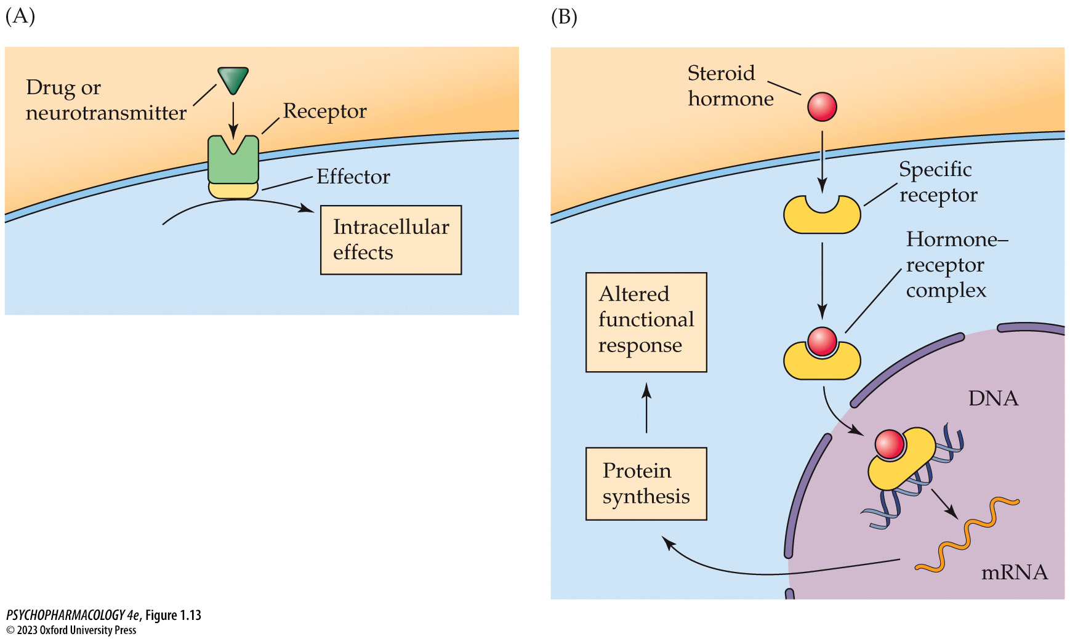
FIGURE 1.13 Two principal types of receptors
Notes:
FIGURE 1.13 Two principal types of receptors
(A) Most drugs and neurotransmitters remain outside the cell and bind to receptors on the exterior cell surface. When these receptors are activated, they initiate changes in an effector, causing intracellular changes such as movement of ions or changes in enzyme activity. (B) Many hormones are capable of entering the cell before acting on an intracellular receptor that changes the expression of specific genes within the nucleus. The altered protein synthesis in turn leads to changes in cell function that may include altering gluconeogenesis, modulating the menstrual cycle, and others.

Slide 42
Pharmacodynamics: Drug–Receptor Interactions (2 of 17)
Extracellular and Intracellular Receptors Have Several Common Features
Receptor agonists have a high affinity for a receptor; bind to receptor and initiate a cellular response.
Receptor antagonists bind to receptor but produce no effects (low efficacy); also prevent agonists from binding
Partial agonists have intermediate efficacy.
Inverse agonists initiate an action opposite to that produced by an agonist.
Notes:
Instructor Notes:
Baseline receptor function (constitutive activity) is unaffected by neutral antagonists, but can be reduced by inverse agonists.
Drug action can vary in efficacy along a continuum from full agonist action with maximal efficacy, to partial agonist action
to the inactive antagonist, to partial inverse agonist action with some inverse efficacy, to full inverse agonist with maximal inverse efficacy.

Slide 43
Pharmacodynamics: Drug–Receptor Interactions (3 of 17)
Extracellular and Intracellular Receptors Have Several Common Features
Ligands bind temporarily; ligand and receptor are both free to bind again.
Ligand binding produces a physical change in the 3-D receptor shape
Up-regulation: increase in number of receptors
Down-regulation: decrease in number of receptors
Notes:
Instructor Notes:
Chronic use of receptor antagonists leads to subsequent up-regulation of receptors. Likewise, drugs that act as agonists cause a reduction in receptors if they are administered repeatedly.

Slide 44
Pharmacodynamics: Drug–Receptor Interactions (4 of 17)
Dose–Response Curves Describe Receptor Activity
Dose–response curve: describes extent of biological or behavioral effect produced by a given drug concentration (dose).
50% effective dose (ED₅₀): the dose that produces half the maximal effect
Threshold: dose that produces the smallest measurable response.
Notes:
Instructor Notes:
At low doses, the drug-induced effect is slight because very few receptors are occupied. As the dose of the drug is increased, more receptors are occupied, and a greater response occurs.

Slide 45
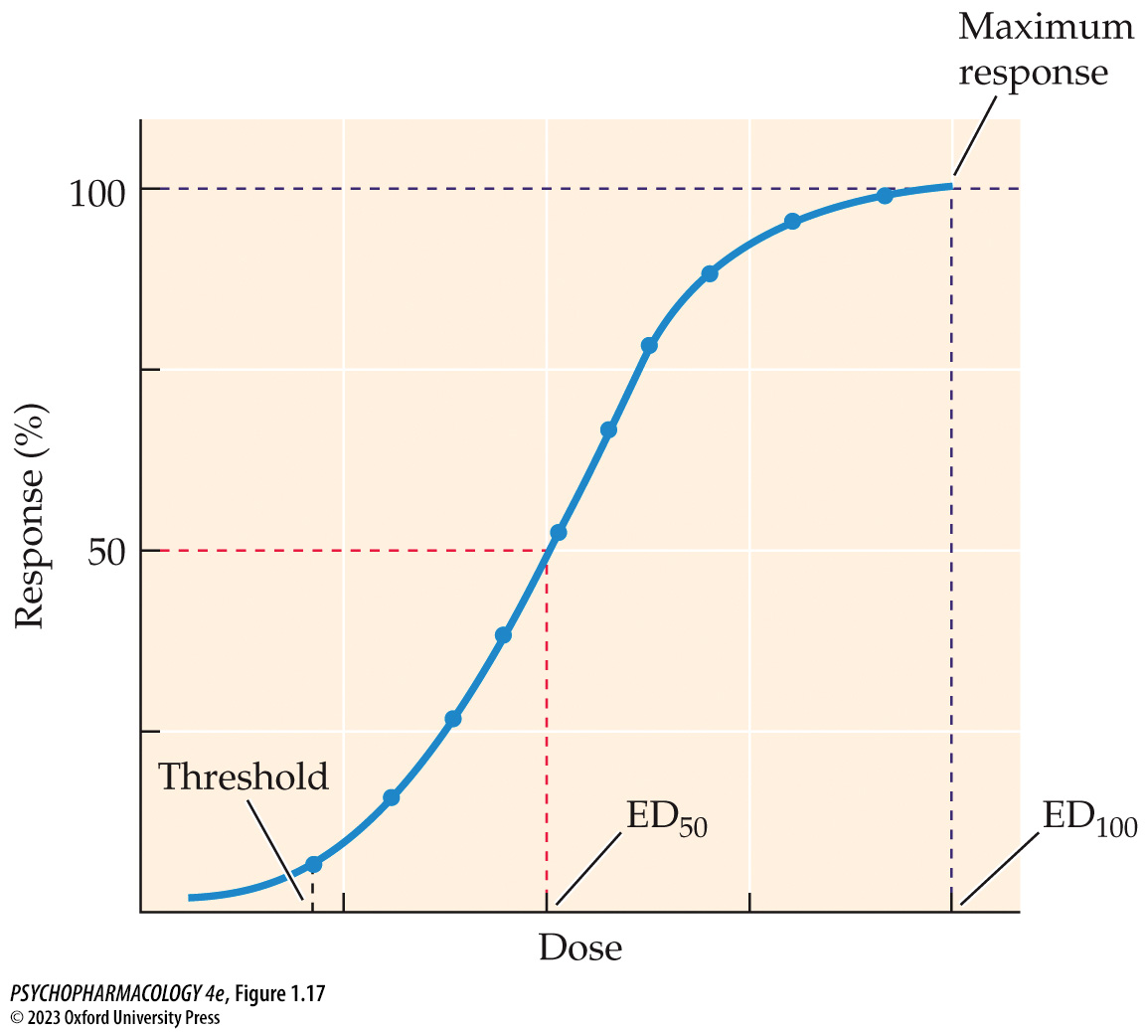
FIGURE 1.17 Dose–response curve
Notes:
FIGURE 1.17 Dose–response curve
The classic S-shape describes the gradual increase in biological response that occurs with increasing doses of a drug (drug–receptor activation). Threshold is the dose that produces the smallest measurable response. The dose at which the maximum response is achieved is the ED₁₀₀ (100% effective dose), and the ED₅₀ is the dose that effectively produces 50% of the maximum response.

Slide 46
Pharmacodynamics: Drug–Receptor Interactions (5 of 17)
Dose–Response Curves Describe Receptor Activity
Potency: amount of drug necessary to produce a specific effect
Comparing ED₅₀ of different drugs shows differences in potency, even if they have identical efficacy.
Notes:
Instructor Notes:

Slide 47
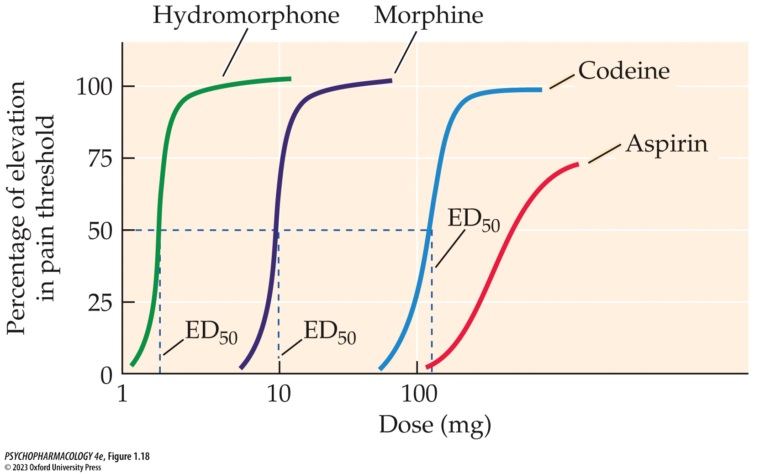
FIGURE 1.18 Dose–response curves for four analgesic agents
Notes:
FIGURE 1.18 Dose–response curves for four analgesic agents
Each curve represents the increase in pain threshold (the magnitude of painful stimulus required to elicit a withdrawal response) as a function of dose. Knowing the ED₅₀ doses for hydromorphone, morphine, and codeine helps when comparing their potency. The linear portions of the curves for the opiate analgesics are parallel, suggesting that they work through the same mechanism. Aspirin is not an opiate and relieves pain by a very different mechanism of action, so the shape of the curve is distinct. In addition, the maximum effectiveness of aspirin never reaches the level of the opiates. (After R. R. Levine, 1973. Pharmacology: Drug Actions and Reactions, 1st ed. Little, Brown, and Co.: Boston. © 1973 by Little, Brown and Company, Inc.)

Slide 48
Pharmacodynamics: Drug–Receptor Interactions (6 of 17)
The Therapeutic Index Calculates Drug Safety
Undesirable or dangerous side effects of a drug must be evaluated carefully in a therapeutic situation.
TD₅₀ (50% toxic dose): dose at which 50% of the population experiences a toxic effect.
Comparing TD₅₀ with ED₅₀ helps determine appropriate doses to prevent toxic effects.
Therapeutic index (TI) = TD₅₀/ED₅₀
Notes:
Instructor Notes:

Slide 49
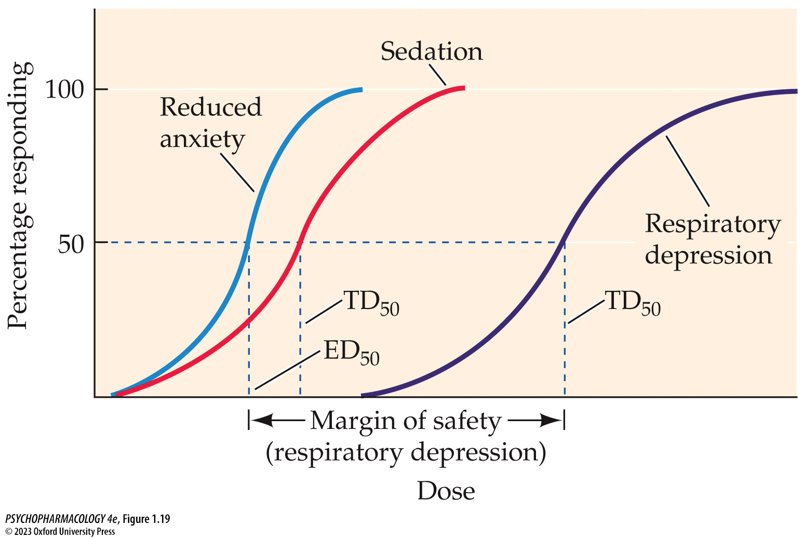
FIGURE 1.19 Comparison of ED₅₀ and TD₅₀
Notes:
FIGURE 1.19 Comparison of ED₅₀ and TD₅₀
The therapeutic index (TI) is calculated by comparing the dose of drug required to produce a toxic effect in 50% of individuals (TD₅₀) with the dose that is effective for 50% (ED₅₀). Each drug may have several therapeutic indices based on its toxic effects or side effects of concern. Because the optimum condition is to have a drug that is effective at a low dose with no toxicity except at very high doses, the TI will be large for a safer drug. The figure shows a large margin of safety for an antianxiety drug that can produce respiratory depression.

Slide 50
Pharmacodynamics: Drug–Receptor Interactions (7 of 17)
Receptor Antagonists Compete with Agonists for Binding Sites
Competitive antagonists: compete with agonists to bind receptors but don’t initiate effects, reducing effect of the agonist.
  Can be displaced by an excess of agonist.
Noncompetitive antagonists: reduce effect of agonists in other ways
Notes:
Instructor Notes:
Noncompetitive antagonists reduce effect of agonists by: Binding to the receptor at a site other than the agonist binding site; Disturbing the cell membrane supporting the receptor; Interfering with cell processes that were initiated by the agonist.

Slide 51
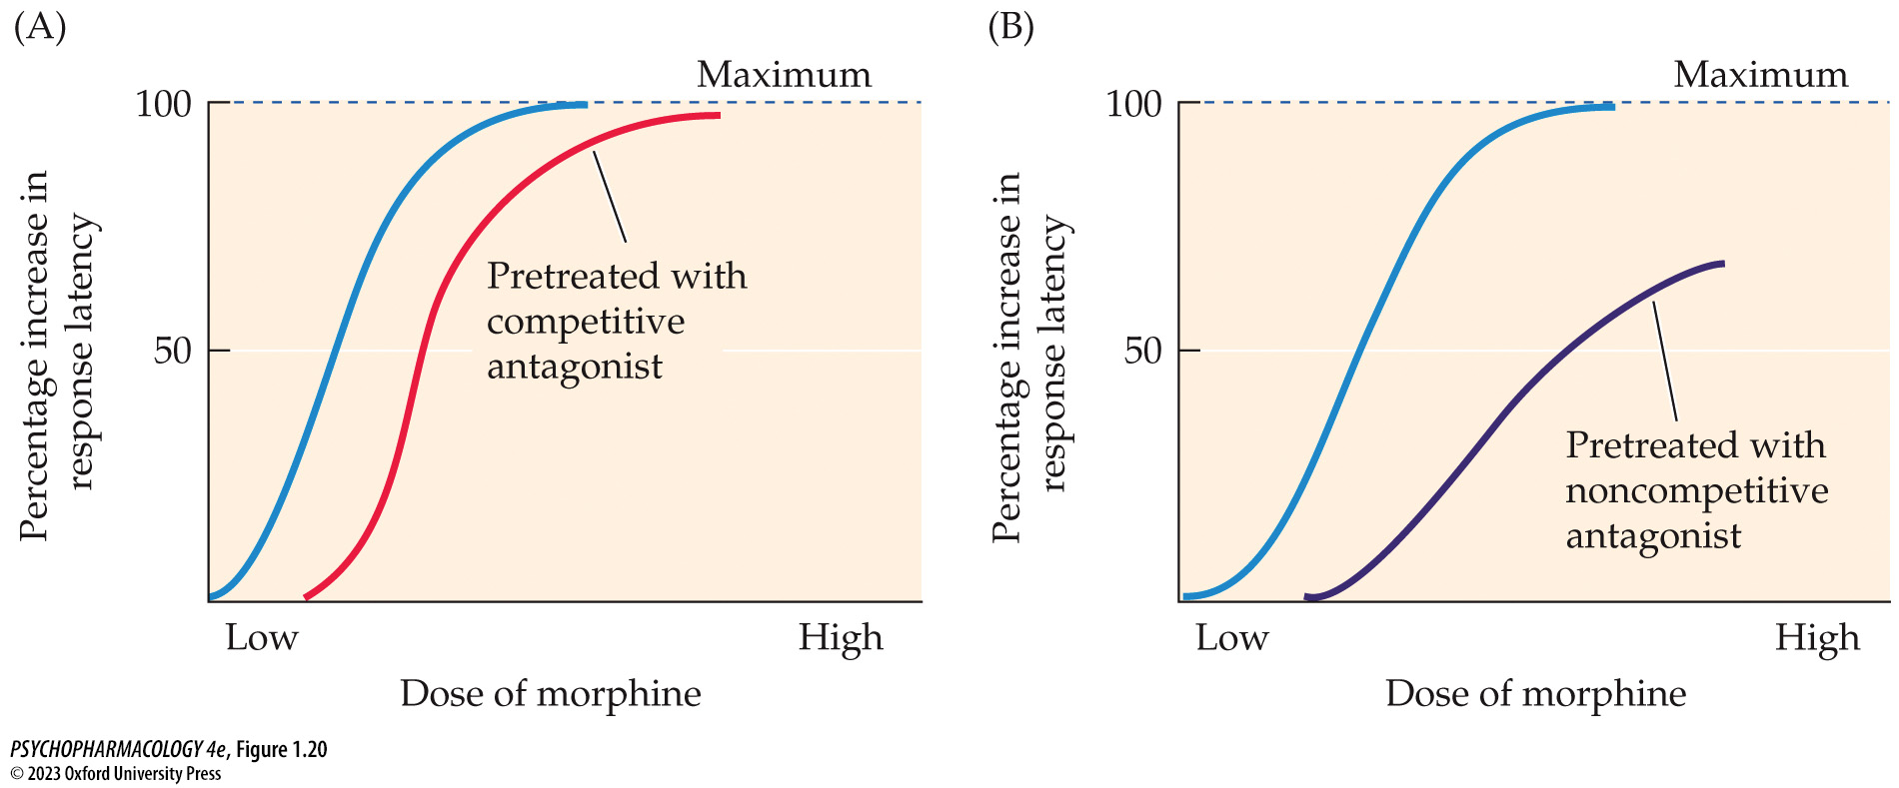
FIGURE 1.20 Drug antagonism
Notes:
FIGURE 1.20 Drug antagonism
(A) The effect of a competitive antagonist (naloxone) on the analgesic effect of morphine. The addition of a competitive antagonist essentially reduces the potency of the agonist, as is shown by the parallel shift of the dose–response curve to the right. (B) In contrast, adding a noncompetitive antagonist usually produces a distinct change in the shape of the dose–response curve, indicating that it does not act at the same receptor site. Also, regardless of the increase in morphine, the maximum efficacy is never reached.

Slide 52
Pharmacodynamics: Drug–Receptor Interactions (8 of 17)
Receptor Antagonists Compete with Agonists for Binding Sites
Physiological antagonism: two drugs interact and reduce the effectiveness of both.
Two drugs may also have additive effects.
Potentiation: the combination of two drugs produces effects greater than the sum of their individual effects.
Notes:
Instructor Notes:

Slide 53
Pharmacodynamics: Drug–Receptor Interactions (9 of 17)
Biobehavioral Effects of Chronic Drug Use
Chronic drug use can change the magnitude of response.
Repeated drug exposure can cause tolerance: a diminished response – increasingly larger doses must be administered to obtain the same magnitude of response
Cross tolerance: tolerance to one drug can diminish effectiveness of a second drug
Notes:
Instructor Notes:

Slide 54
Pharmacodynamics: Drug–Receptor Interactions (10 of 17)
Repeated Drug Exposure Can Cause Tolerance
Tolerance is reversible.
Extent of tolerance depends on dose and frequency of use, and the environment in which it occurs.
Acute tolerance develops after one administration.
Development of tolerance to the different effects of one drug may be uneven.
Notes:
Instructor Notes:
Acute tolerance: as when an individual experiences significantly greater effects of alcohol as his blood level rises than he experiences several hours later, when his blood level has fallen to the same point.

Slide 55
Pharmacodynamics: Drug–Receptor Interactions (11 of 17)
Repeated Drug Exposure Can Cause Tolerance
Types of tolerance:
  Metabolic: when drugs increase their own rate of metabolism by liver microsomal enzyme induction
  Pharmacodynamic: neural function changes to adapt to continued presence of the drug by up- or down-regulation.
  Behavioral: occurs in the same environment in which the drug was administered
Notes:
Instructor Note
Metabolic tolerance also called drug disposition tolerance
Pharmacodynamic tolerance helps explain withdrawal syndrome - the adaptive mechanism produces effects opposite to the initial drug effects; when the drug
is no longer present, the adaptive mechanism remains functioning. Withdrawal syndrome is the hallmark of physical dependence.

Slide 56
Pharmacodynamics: Drug–Receptor Interactions (12 of 17)
Repeated Drug Exposure Can Cause Tolerance
Behavioral tolerance involves learning:
  Pavlovian, or classical conditioning: the drug-taking procedure or the environment may elicit a conditioned response
  Operant conditioning: e.g., an individual with alcohol use disorder learns to maneuver efficiently while intoxicated.
  State-dependent learning: tasks learned under the influence of a psychoactive drug may then be performed better in the drugged state
Notes:
Instructor Note

Slide 57
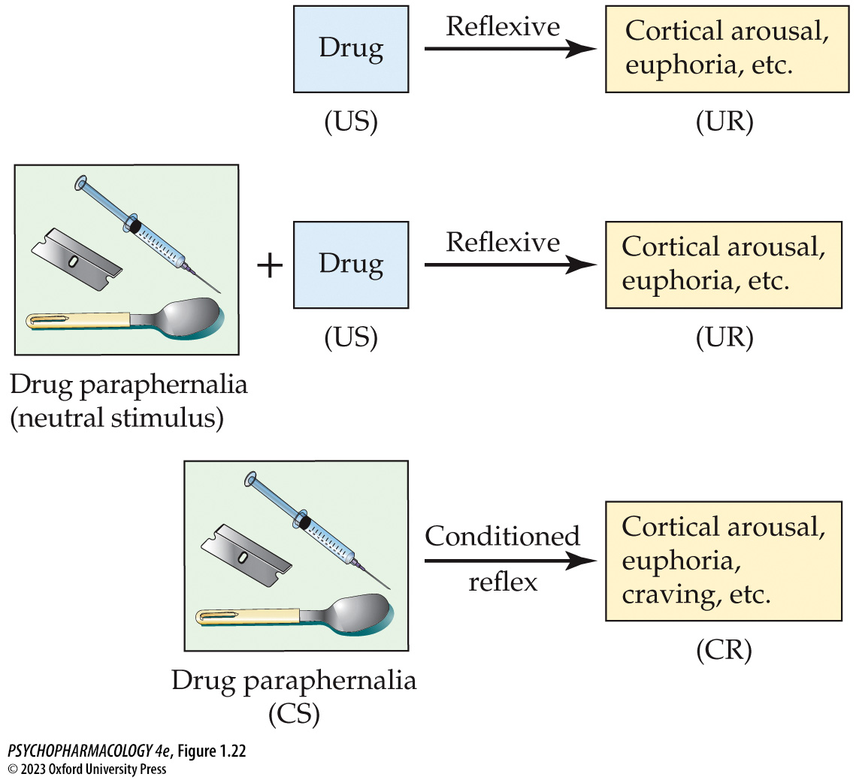
FIGURE 1.22 Classical conditioning of drug-related cues
Notes:
FIGURE 1.22 Classical conditioning of drug-related cues
Although drug-taking equipment and the immediate environment initially serve as meaningless stimuli for the individual, their repeated pairing with the drug (unconditioned stimulus; US), which naturally elicits euphoria, arousal, or other desirable effects (unconditioned response; UR), gives the drug-­taking equipment new meaning. Ultimately, the equipment and the environment alone (now a conditioned stimulus; CS) could elicit drug effects (conditioned response; CR) in the absence of the drug.

Slide 58
Pharmacodynamics: Drug–Receptor Interactions (13 of 17)
Chronic Drug Use Can Cause Sensitization
Sensitization, or reverse tolerance: enhancement of drug effects after repeated administration
Development is dose-dependent; interval between treatments is important
Cross-sensitization has also been documented
Notes:
Instructor Notes:

Slide 59
Pharmacodynamics: Drug–Receptor Interactions (14 of 17)
Pharmacogenetics and Personalized Medicine in Psychiatry
Pharmacogenetics: study of the genetic basis for variability in drug response among individuals.
Genetic variation in drug-metabolizing enzymes: cytochrome P450 enzyme family genes have many polymorphisms
Drug dosage could be adjusted if an individual’s genetic makeup is known.
Notes:
Instructor Notes:
Goal of pharmcogenetics: Identify genetic factors that confer susceptibility to specific side effects, or predict a therapeutic response to select appropriate drugs and dosages for an individual.

Slide 60
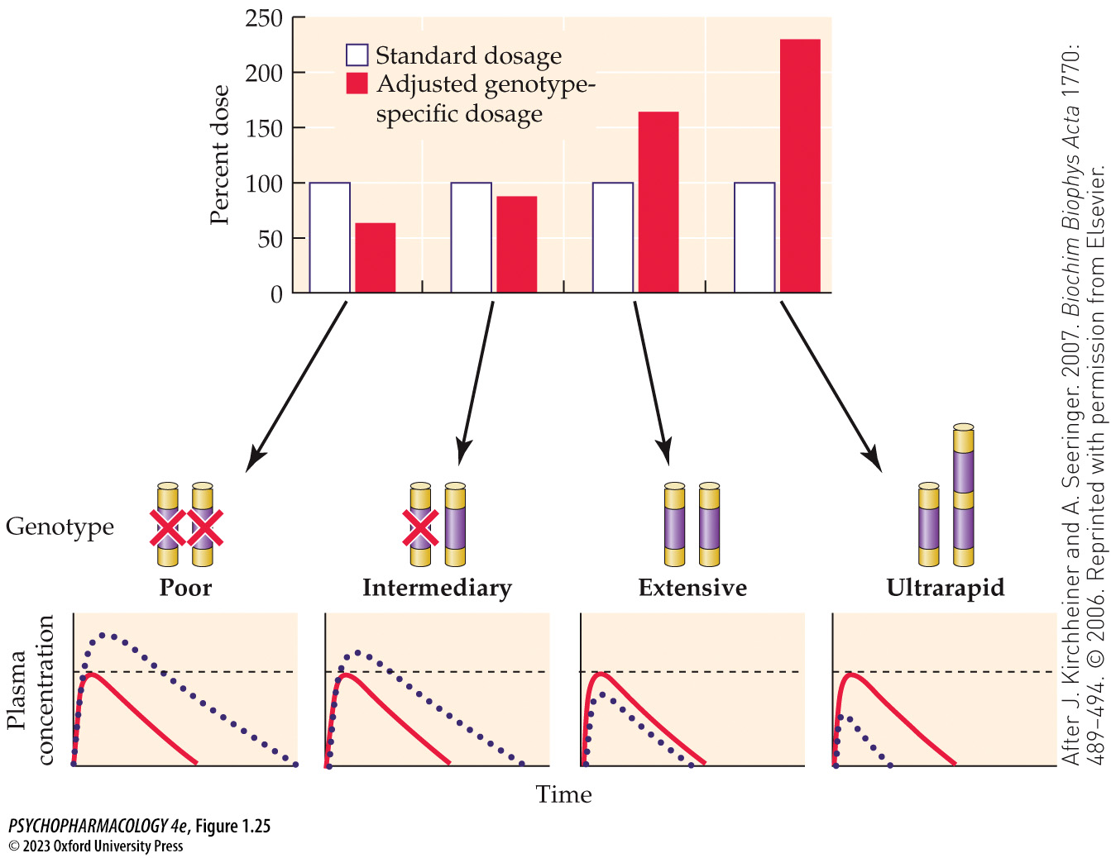
FIGURE 1.25 Drug dosage adjustments based on genotype
Notes:
FIGURE 1.25 Drug dosage adjustments based on genotype
Compared with standard dosages (open), theoretical dosages (solid red) were estimated based on drug-­metabolizing genotype in order to achieve equal drug plasma concentration time courses to maximize therapeutic efficacy and avoid unwanted adverse effects. See text for details. (After J. Kirchheiner and A. Seeringer. 2007. Biochim Biophys Acta 1770: 489–494. © 2006. Reprinted with permission from Elsevier.)

Slide 61
Pharmacodynamics: Drug–Receptor Interactions (15 of 17)
Pharmacogenetics and Personalized Medicine in Psychiatry
Multiple genetic factors, demographic factors, environmental factors, and use of multiple medications can also alter drug metabolism.
Pharmacoepigenetics takes into account the role of epigenetic modifications that can alter gene function and arise from environmental and behavioral factors.
Notes:
Instructor Notes:

Slide 62
Pharmacodynamics: Drug–Receptor Interactions (16 of 17)
Pharmacogenetics and Personalized Medicine in Psychiatry
Routine genetic screening will provide several advantages.
Predicting how patients will respond to a medication before treatment begins would avoid the current costly and time-consuming method of trial and error.
Genetic screening is still limited, but pharmacogenetics holds great promise for better psychiatric treatment.
Notes:
Instructor Notes:

Slide 63
Pharmacodynamics: Drug–Receptor Interactions (17 of 17)
CLICKER QUESTION 3
Which of these parameters in dose-response studies is used to assess drug safety? (Select all that apply.)
ED₅₀
TD₅₀
Threshold dose
TI
Notes:
Instructor Notes
Correct answer: b and d

Slide 64
Review of Learning Objectives (3 of 4)
1.2.1 Describe how drugs interact with the target tissue in terms of receptor-ligand binding.
1.2.2 Explain how receptor-ligand binding can be described in terms of affinity and efficacy; use these terms to describe how a drug is defined as an agonist, partial agonist, or antagonist.
1.2.3 Describe how dose-response relationships reflect receptor occupancy and activation, and can be used to describe the relative potency of a drug.

Slide 65
Review of Learning Objectives (4 of 4)
1.2.4 Explain the difference between competitive and non-competitive antagonists, and how co-administration of either of these would alter the dose-response curve of a receptor agonist.
1.2.5 Explain how the concept of therapeutic index is used to determine the relative safety of a drug.
1.2.6 Define tolerance and sensitization. Describe the mechanistic differences between pharmacodynamic, metabolic and behavioral tolerance.
1.2.7 Describe how pharmacogenetics can be used to optimize drug selection and dose based on genetic variability across individuals.

